Slide 1
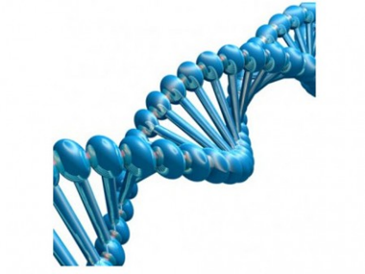
Point of Care Diagnostics; Molecular Diagnostics
18.7.15 Principles and use of molecular diagnostics
18.7.14 Principles and use of point-of-care diagnostics
Unit C18.7 Maintaining Laboratory Equipment
Module 279 19 C Medical Instrumentation II
©
dr. Chris R. Mol, BME, NORTEC, 2016

Slide 2
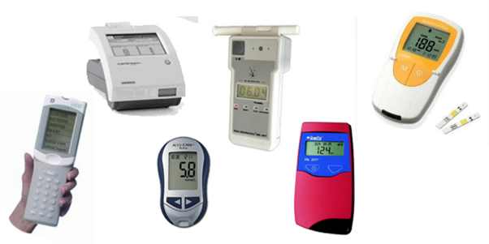
Point of Care Diagnostics
Point of Care (PoC) tests are the same tests as carried out in the Clinical Laboratory. However, PoC tests are designed to be used at the site where the patient is located, outside the clinical laboratory. A classic example of a PoC test is the bedside glucose testing in the hospital.
Point-of-care testing allows patient diagnoses in any location: the physician’s office, an ambulance, the home, the field, or in the hospital.
The results of the tests are timely, and allow rapid diagnosis and treatment for the patient.
Enabling clinicians to make decisions at the “point-of-care” has the potential to significantly impact health care delivery in shifting from curative to preventive medicine and screening through easier access to tests, e.g. in home use.
©
Point of Care Diagnostics
dr. Chris R. Mol, BME, NORTEC, 2016

Slide 3
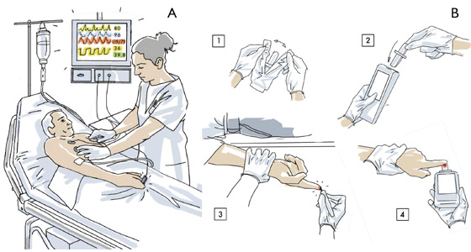
Point of Care Testing
©
Point of Care Diagnostics
dr. Chris R. Mol, BME, NORTEC, 2016

Slide 4
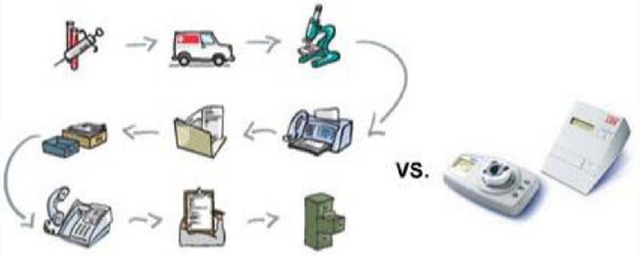
Conventional Lab Testing versus Point of Care Testing
PoC testing contrasts with the ‘historical’ (current) pattern in which testing was confined to the medical laboratory. This included sending off specimens away from the point of care and then waiting hours or days to learn the results, during which time care must continue without the desired information.
Point-of-care testing brings speed and simplicity in organization
©
Point of Care Diagnostics
dr. Chris R. Mol, BME, NORTEC, 2016

Slide 5
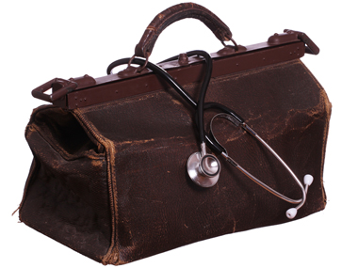
Point of Care Testing: Yesterday
In the earliest days of medicine, health care was similar to point-of-care in that it was delivered in the patient’s home through physician house visits.
As medical discoveries were made and new technologies developed, care then shifted to specialized hospitals with an emphasis on curative medicine.
Large centralized laboratories were established, with cost-savings realized through the development of automated systems for analysis of patient samples.
Point-of-care devices were used on a limited basis in the hospital for rapid analysis in intensive care units and for simple home testing, such as with pregnancy test kits.
European traditional physician’s bag containing all materials for diagnosing and treating patients during home visits.
Will this also be the future?
©
Point of Care Diagnostics
dr. Chris R. Mol, BME, NORTEC, 2016

Slide 6
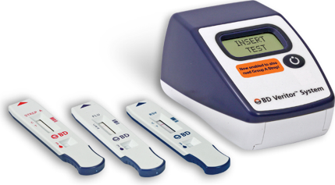
Point of Care Testing: Today
Today, the emphasis of care is shifting toward prevention and early detection of disease, as well as the management of multiple chronic conditions.
Point-of-care testing gives immediate results in non-laboratory settings. Innovation creates new sensors and micro-systems and low-cost imaging technologies for point-of-care testing. These instruments are self-contained, portable devices that can be used by non-specialists to detect and diagnose disease.
For example, sensor technologies enable the rapid analysis of blood samples for blood chemistry, electrolytes, blood gases, and hematology.
Biosensors are used clinically for toxicology, measurement of blood cells and blood coagulations, bedside diagnosis of heart disease through detection of cardiac markers in the blood, and glucose self-testing.
Current developments in point-of-care testing are addressing the challenges of diagnosis and treatment of cancer, stroke, and cardiac patients.
©
Point of Care Diagnostics
dr. Chris R. Mol, BME, NORTEC, 2016

Slide 7
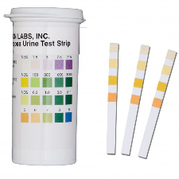
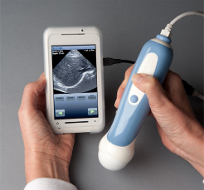
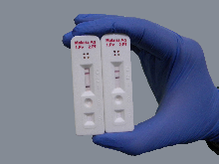
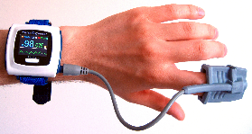
Point of Care Testing: Today examples
Various kinds of urine test strips have been available for decades.
Bedside glucose testing
Portable ultrasonography did not reach the stage of being advanced, affordable, and widespread until the 2000s and 2010s.
Pulse oximetry can test arterial oxygen saturation in a quick, simple, non-invasive, affordable way today, but in earlier eras this required an intra-arterial needle puncture and a laboratory test.
Malaria antigen detection tests rely on a state of the art in immunology that did not exist until recent decades.
©
Point of Care Diagnostics
dr. Chris R. Mol, BME, NORTEC, 2016

Slide 8
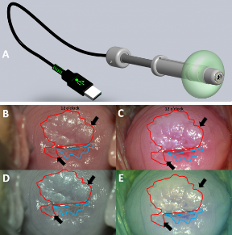
Point of Care Testing: tomorrow
Further development of miniaturized devices and wireless communication, as well as further precision and efficiencies will further change healthcare in this direction.
Low-cost diagnostic imaging devices can be used at the point-of-patient care for under-served populations.
For example, a new method using an optical probe for cervical cancer detection and treatment could significantly lower the mortality rate worldwide. Combining a small optical imaging device with a treatment modality could provide both diagnosis and treatment of cervical cancer at the same time.
Over the next decades, testing will continue to move toward the point of care.
©
Point of Care Diagnostics
dr. Chris R. Mol, BME, NORTEC, 2016

Slide 9
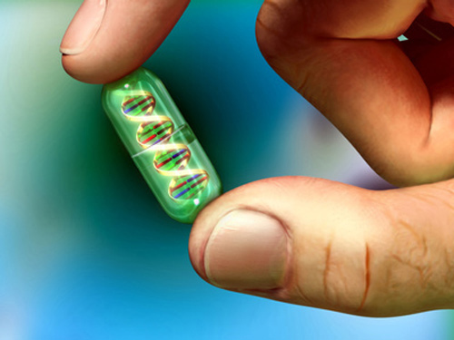
Molecular Diagnostics
Principles and use of molecular diagnostics
©
dr. Chris R. Mol, BME, NORTEC, 2016

Slide 10
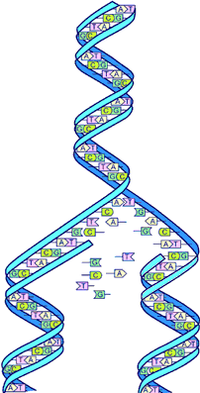
The Human Genome
The human genome contains all genetic material and is the recipe/blueprint for a human being.
It is composed of DNA and contains 30,000 genes, which each contain 3 billion nucleotides of which we have four different versions (A, T, G, C). Nucleotides can be regarded as the letters in the ‘genetic’ alphabet. A strand of DNA, therefore, is a chain of nucleotides.
In 2003, for the first time the genome of a human being was ‘mapped’.
The genes are divided over 23 pairs of chromosomes
The sequence of the nucleotides is more than 99% identical in all people. The one percent of sequences that are variable is responsible for all differences that occur among humans.
DNA:
the double helix
The fact that we have mapped the genome means that we know the ‘sequence of letters’. We now can ‘read’ the recipe but we don’t know what (most of) the letters and words mean…..
With molecular diagnostics, we have tests to detect the presence of certain nucleotide chains (or ‘words’ in the recipe).
©
dr. Chris R. Mol, BME, NORTEC, 2016

Slide 11
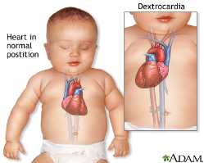
Gene Mutations
There are three kinds of gene mutations, which are changes in a sequence of nucleotides. These are:
hereditary – a mutation that is passed from parent to child;
de novo (‘new’) – new mutations that arise in the egg or sperm cell, or shortly after fertilization, and so are repeated throughout the body; or
somatic – those that arise during life from environmental causes or through an error in DNA replication, and are typically present in tumor cells (cancer).
©
dr. Chris R. Mol, BME, NORTEC, 2016

Slide 12
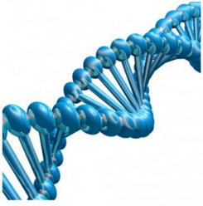
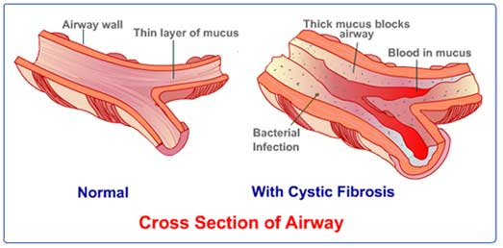
Molecular Diagnostics
Molecular diagnostics is a rapidly developing series of new lab tests that can be applied to human samples. It is a new test domain, next to biochemistry, microbiology, hematology, etc.
Molecular diagnostics detect and measure the presence of genetic material (nucleotide chains) or proteins associated with a specific health condition or disease. This can show whether a specific person:
is predisposed to have a disease,
actually has a disease, or
whether a certain treatment option is likely to be effective for a specific disease.
For example, molecular diagnostic tests can help couples considering to have children to know if they are carriers of a cystic fibrosis gene mutation and therefore at risk of having a child affected by cystic fibrosis.
Many of our body processes are driven by the actions of our genes and related proteins.
It is at this molecular level that we can often find the root causes of a disease.
©
dr. Chris R. Mol, BME, NORTEC, 2016

Slide 13
Personalized Medicine
The term “personalized medicine” has arisen from this field of molecular discovery. It means that the understanding the molecular mechanisms enables medical doctors to evolve
away from treating every patient based on what they have broadly in common with other patients (e.g., ‘lung cancer’)
to treating them as individuals (e.g., a patient has a specific gene mutation in their cancer that is associated with a specific type of lung cancer).
The ability to quickly and accurately assess an individual’s health at this molecular level is transforming the practice of medicine.
©
dr. Chris R. Mol, BME, NORTEC, 2016

Slide 14
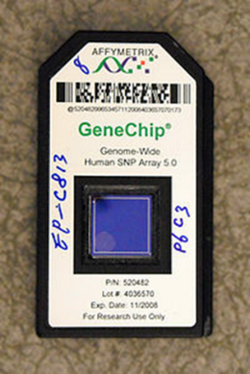
Molecular Diagnostics example: HIV viral load
Some of the most common monitoring molecular tests are tests for HIV viral load in patients affected with HIV. HIV viral load tests are tests that measure the amount of HIV affected genetic material to determine how many copies of the virus are present (measured in copies per milliliter of blood). Keeping viral levels as low as possible is important to staying healthy with HIV.
Because researchers and physicians have made great strides in the care of HIV patients in the three decades since HIV was first detected, essentially transitioning it into a chronic disease in many developed countries, the HIV viral load test has become an essential tool as patients cycle through different antiretroviral therapies and develop resistance to certain therapies. Periodic HIV viral load tests indicate whether or not the disease is progressing, either because an untreated patient’s immune system can no longer suppress replication of the virus, or because the therapy for a patient in treatment is no longer working.
The HIV viral load test is not used for initial diagnosis (this is often done with antibody tests), but typically also is used upon initial diagnosis as a staging diagnostic, to get a first report on the progression of the disease prior to treatment.
©
dr. Chris R. Mol, BME, NORTEC, 2016

Slide 15
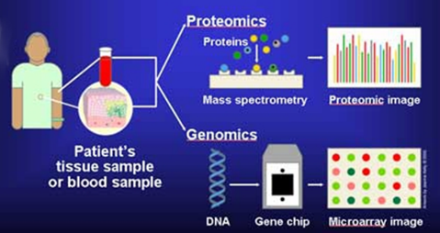
Molecular Diagnostics Techniques
Different techniques are employed to detect and quantify specific DNA sequences, as well as proteins. These are all highly sophisticated and their explanation is not a part of this course module.
In situ hybridization
Microarray (gene) chips —prefabricated chips that test many markers at once
Mass spectrometry
Sequencing
In general, each molecular assay (test) requires three basic steps:
The extraction and purification of nucleic acid.
Strengthening (making copies of) the nucleic acid of interest
The detection of the target
These three steps can be performed by three separate devices or combined into one device.
A simple blood sample can be enough to sample genetic information from tumours, transplants or an unborn fetus
©
dr. Chris R. Mol, BME, NORTEC, 2016

Slide 16
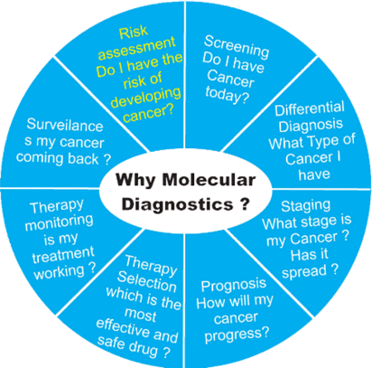
Applications
Conventional prenatal tests for chromosomal abnormalities such as Down Syndrome
Infectious diseases such as chlamydia, influenza virus and tuberculosis; or specific strains such as H1N1 virus.
Disease risk management:
A patient's genome may include an inherited or random mutation which affects the probability of developing a disease in the future. For example, Lynch syndrome is a genetic disease that predisposes patients to certain cancers; early detection can lead to close monitoring that improves the patient's chances of a good outcome.
Cardiovascular risk is indicated by biological markers and screening can measure the risk that a child will be born with a genetic disease such as cystic fibrosis.
Genetic testing is ethically complex: patients may not want the stress of knowing their risk. In countries without universal healthcare, a known risk may raise insurance premiums.
©
dr. Chris R. Mol, BME, NORTEC, 2016

Slide 17
END
The creation of this presentation was supported by a grant from THET:
see https://www.thet.org/

